Slide 1
Ethical Issues with
Drones
Brady Chin
Colorado State University Global
CSC502-1: Ethical Leadership in Software Development
Dr. Dong Nguyen
October 6th, 2024

Slide 2
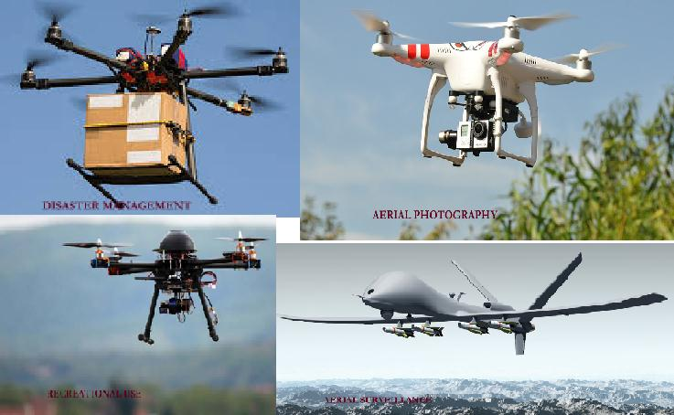
Key Points Surrounding Drone Ethics
Figure 1
Types of drones
Privacy Concerns
Safety Risks
Job Displacement
Data Misuse
Military Use
Note: Adapted from Drones - Unmanned Aerial Vehicle, by Menon, R., 2017, March 22, Trydale (https://trydale.com/drones-unmanned-aerial-vehicle/)

Slide 3
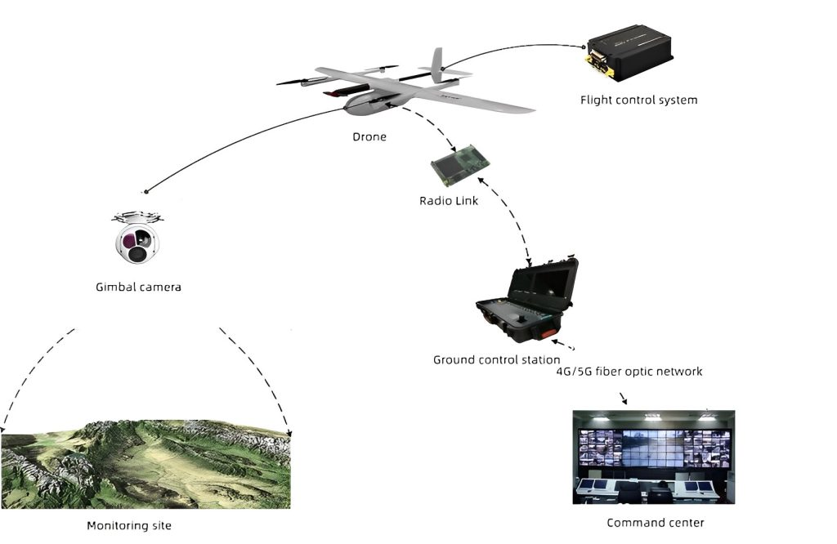
Privacy Concerns
Figure 2
Drone surveillance technology and components
Drones equipped with surveillance technology
Able to capture images and videos of individuals without their consent (Rice, S., 2019, February 4).
Lack of privacy standards and regulations (Bennett, W. C., 2014, September)
The U.S. Congress has not passed a bill to set privacy standards or regulate drones (REFERENCE).
There is pushback from “drone federalists”: scholars and policymakers who oppose federal drone statute and want to keep federal regulation to a minimum.
Note: Adapted from What is drone surveillance?, by JOUAV Unmanned Aircraft System, 2024 (https://www.jouav.com/industry/security-surveillance)

Slide 4
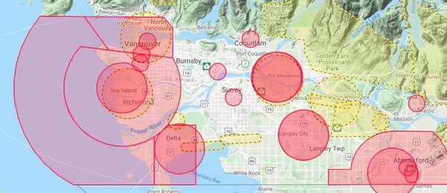
Safety Risks
Collision risks
Drones can cause damage or harm by flying into buildings, people, or obstacles.
Flying into the controlled airspace
Potential to collide with manned aircrafts.
Strict regulations have been established to fly drones near or in controlled airspace (Federal Aviation Administration, 2022, June 14)
Cyber attacks through drone
Hackers can gain remote control of drones and fly into unauthorized locations compromising security (AO Kaspersky Lab, 2024).
Figure 3
Greater Vancouver airspace
Note: Adapted from How to identify Airspace for Drone operations, by Dinh, V., 2020, September 3, Candrone (https://candrone.com/blogs/news/how-to-identify-airspace-for-drone-operations)

Slide 5
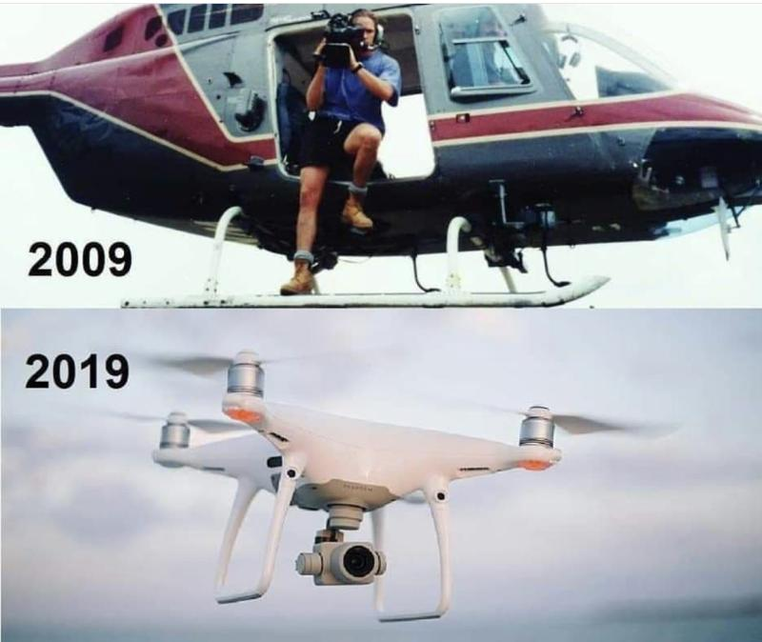
Job Displacement
Agriculture
Drones automate crop monitoring and precision farming that was originally done by humans (Malkoff, D., 2024, March 19).
Delivery services
Drone delivery systems replace traditional delivery roles decreasing the need for human delivery drivers (Delucci, R., 2023, April 24).
Aerial photography
A single drone will take the jobs of both a helicopter pilot and photographer.
Figure 4
10 year evolution of aerial photography
Note: Adapted from In the last 10 years the helicopter pilot and photographer both lost their job. Are u upgrading urself., by Mall, S., 2019, December 4 (https://x.com/SandeepMall/status/1202254630891114496)

Slide 6
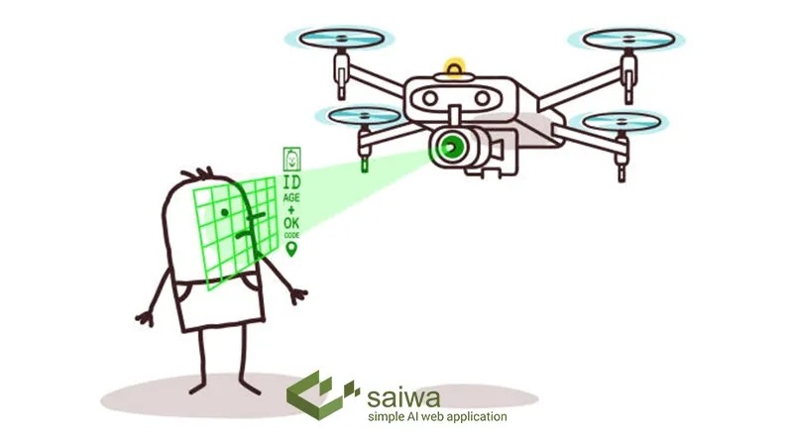
Data Misuse
Unauthorized data collection (Jackman, A., 2024, January 22)
There is a lack of consent with the use of drones in a public spaces. This data can include images, videos, and personal activities.
Use of facial recognition
Identify and profile people in public or private settings.
Can be used to track individuals from a distance in real-time.
Geolocation tracking
Allows for tracking individuals location through precise geolocation data.
Figure 5
Facial recognition technology in drones
Note: Adapted from Facial Recognition Drones | A Comprehensive Guide, by Saiwa, 2024, June 8. (https://saiwa.ai/blog/Facial-Recognition-Drones/)

Slide 7
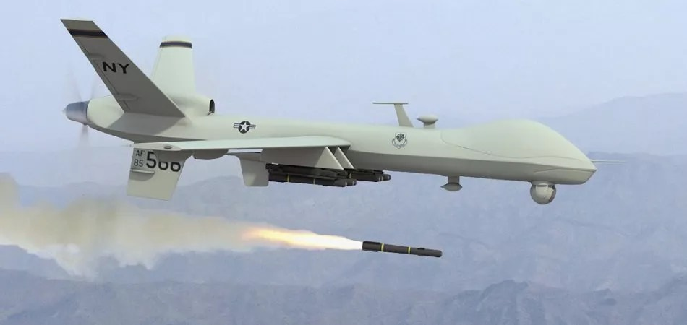
Military Use
Removes human element from combat
Leads to detachment from the consequences of drone pilots actions.
There is a lack of accountability with humans removed from the decision making process (Falcon Scientific Editing, 2023, September 12)
Mistakenly target civilians
While minimizing solder casualties, it can mistakenly harm civilians (Vergun, D., 2021, November 3).
Automation warefare
AI in drones will have to make life or death decisions.
Figure 5
Facial recognition technology in drones
Note: Adapted from AI in Military Drones and UAV’s - Current Applications, by Roth, M., 2019, November 22, Emerj. (https://emerj.com/ai-sector-overviews/ai-drones-and-uavs-in-the-military-current-applications/)

Slide 8
References
AO Kaspersky Lab (2024) Security and drones - what you need to know. Kaspersky. https://usa.kaspersky.com/resource-center/threats/can-drones-be-hacked
Bennett, W. C. (2014, September) Civilian drones, privacy, and the federal-state balance. Brookings. https://www.brookings.edu/articles/civilian-drones-privacy-and-the-federal-state-balance/
Delucci, R., (2023, April 24) Will drones replace food delivery drivers? Food Grade Packaging. https://packagingfg.com/2023/04/24/food-delivery-drivers-replaced-by-drone/
Falcon Scientific Editing (2023, September 12) The Role of Ethics in Autonomous Drone Technology. https://falconediting.com/en/blog/the-role-of-ethics-in-autonomous-drone-technology/
Federal Aviation Administration (2022, June 14) Airspace Restrictions. https://www.faa.gov/uas/getting_started/where_can_i_fly/airspace_restrictions/flying_near_airports
Jackman, A., (2024, January 22) Drone incidents and misuse: legal considerations. University of Reading. https://research.reading.ac.uk/research-blog/2024/01/22/drone-incidents-and-misuse-legal-considerations/
Malkoff, D., (2024, March 19) Drone and robots could replace some field workers as farming goes high-tech. CBS News. https://www.cbsnews.com/news/farming-goes-high-tech/
Rice, S., (2019, February 4) Eyes in the Sky: The Public Has Privacy Concerns About Drones. Forbes. https://www.forbes.com/sites/stephenrice1/2019/02/04/eyes-in-the-sky-the-public-has-privacy-concerns-about-drones/
Vergun, D., (2021, November 3) Air Force Official Briefs Media on Deadly Drone Strike in Kabul. U.S. Department of Defense. https://www.defense.gov/News/News-Stories/Article/Article/2831896/air-force-official-briefs-media-on-deadly-drone-strike-in-kabul/

